Slide 1
An Overview of the Stata Environment
University of Arizona, School of Sociology
SOC570A to SOC570B
Transitioning from R to Stata

Slide 2
This PowerPoint will briefly overview the Stata environment and its important components.
The Stata environment is similar to the one found in RStudio, but not exact.
Nevertheless, most of what we can do in R is accomplishable in Stata. In fact, Stata does some things better than R.

Slide 3
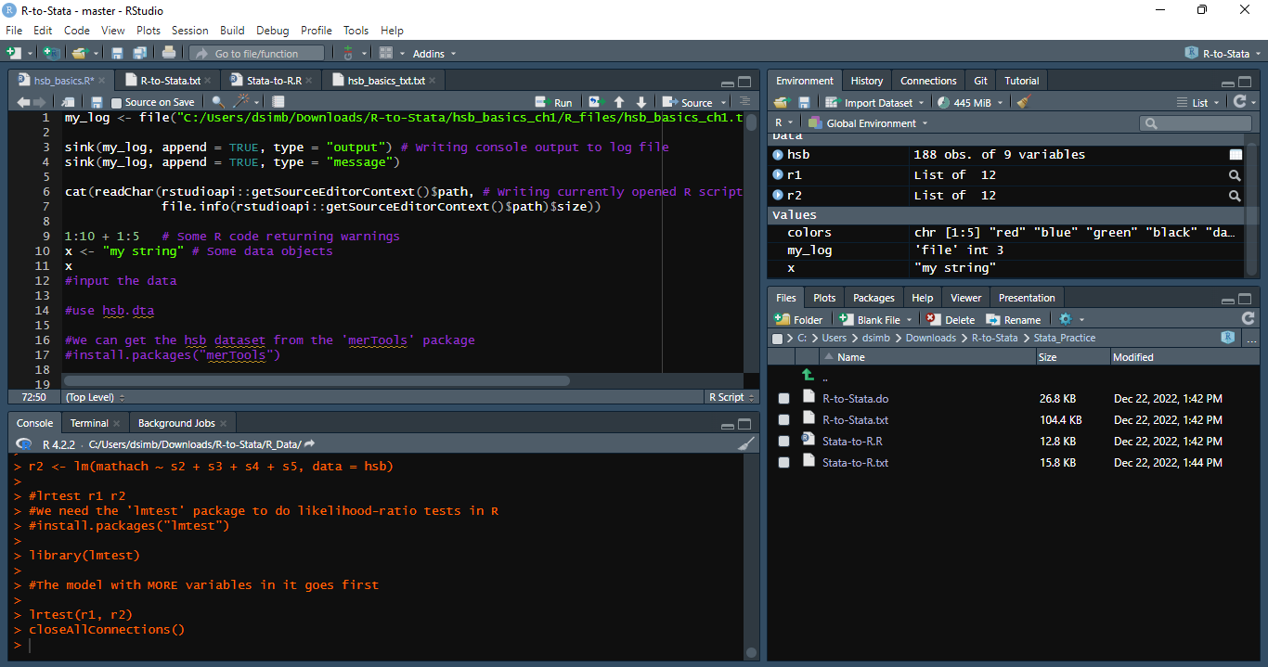
The RStudio Environment

Slide 4
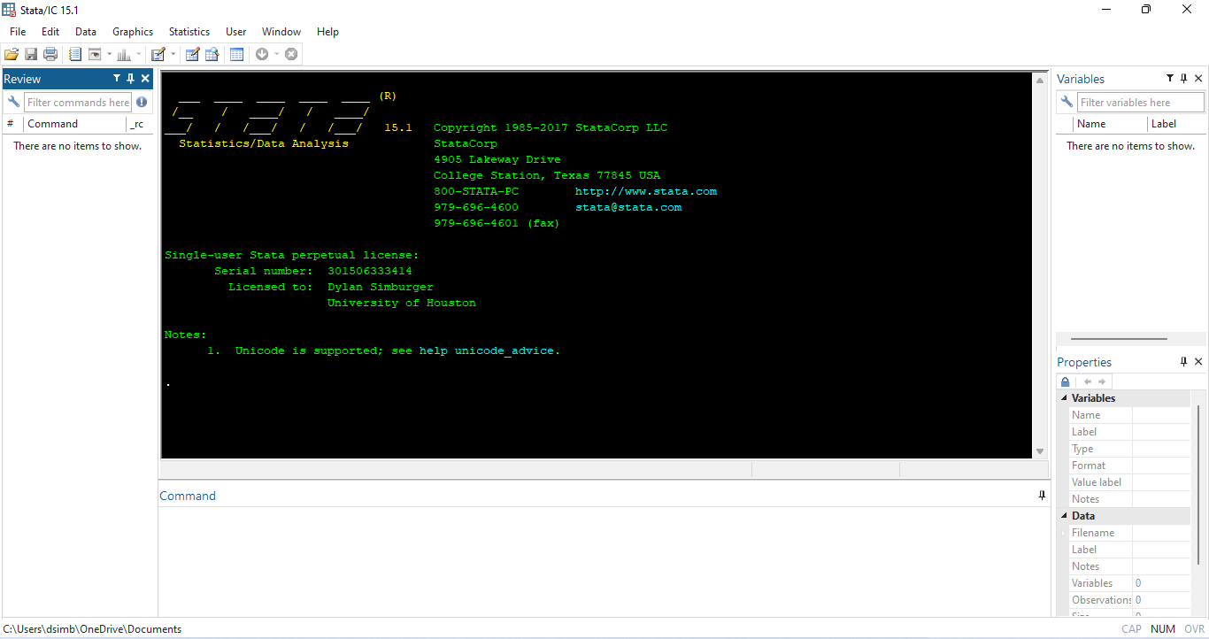
The Stata Environment

Slide 5
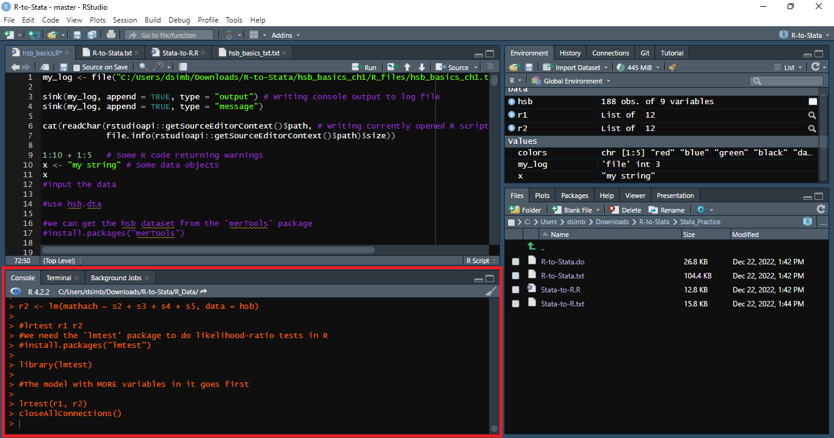
The RStudio Console

Slide 6
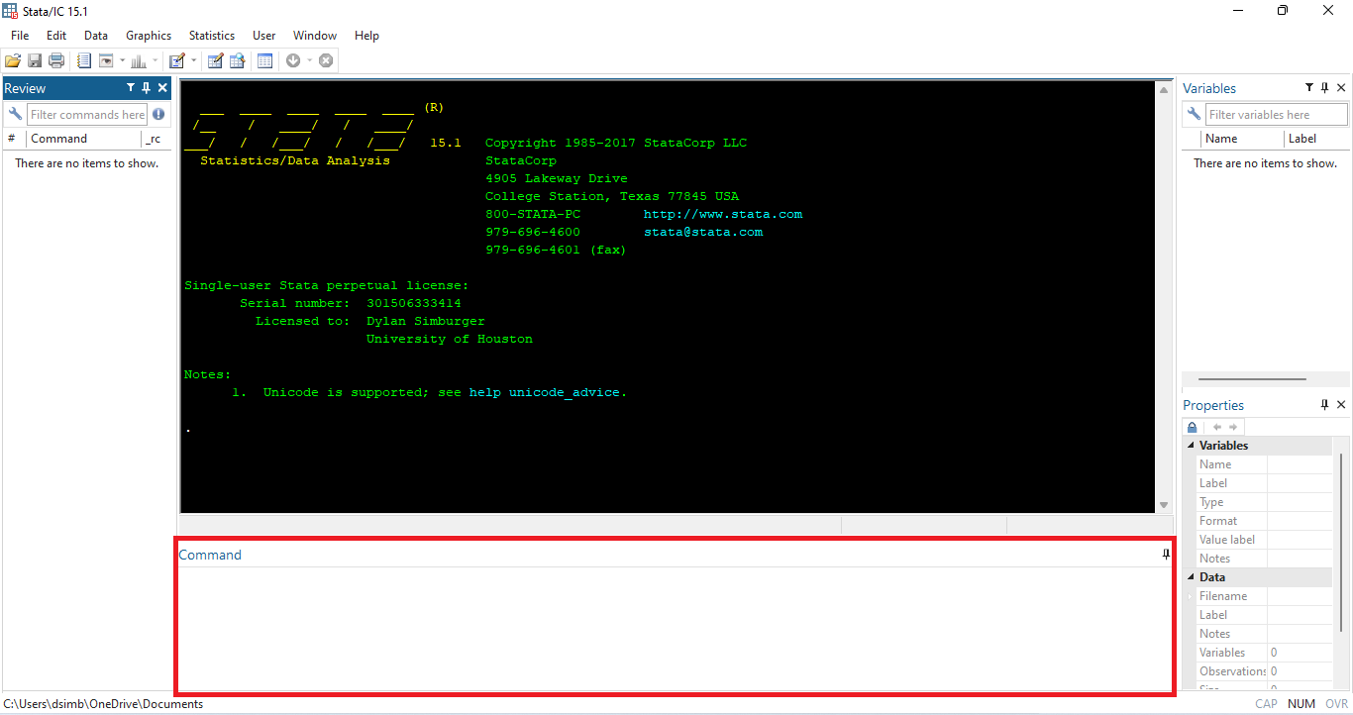
The Stata Console

Slide 7
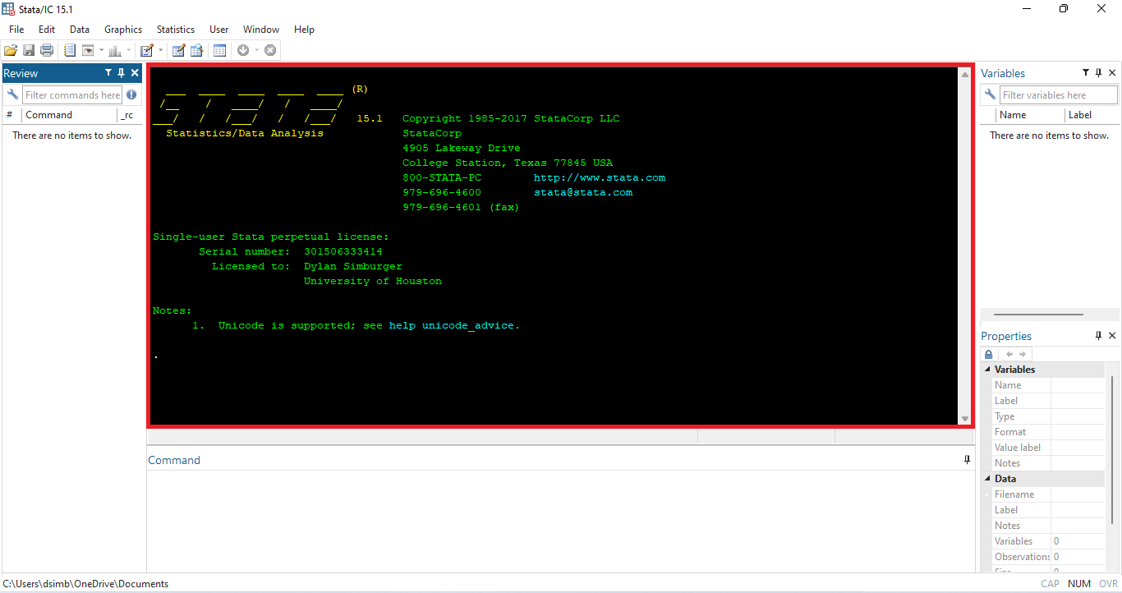
The Stata Output Window

Slide 8
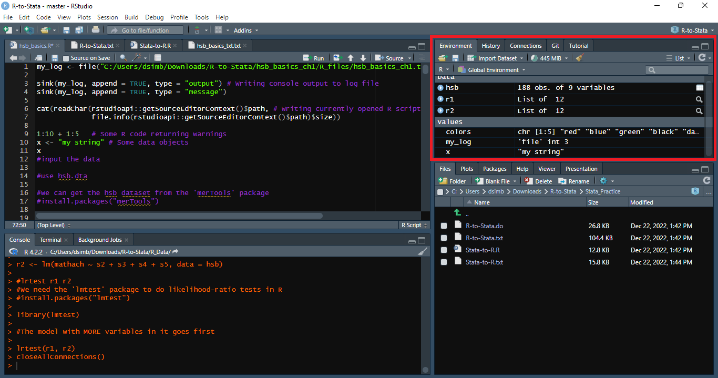
The RStudio Object Environment

Slide 9
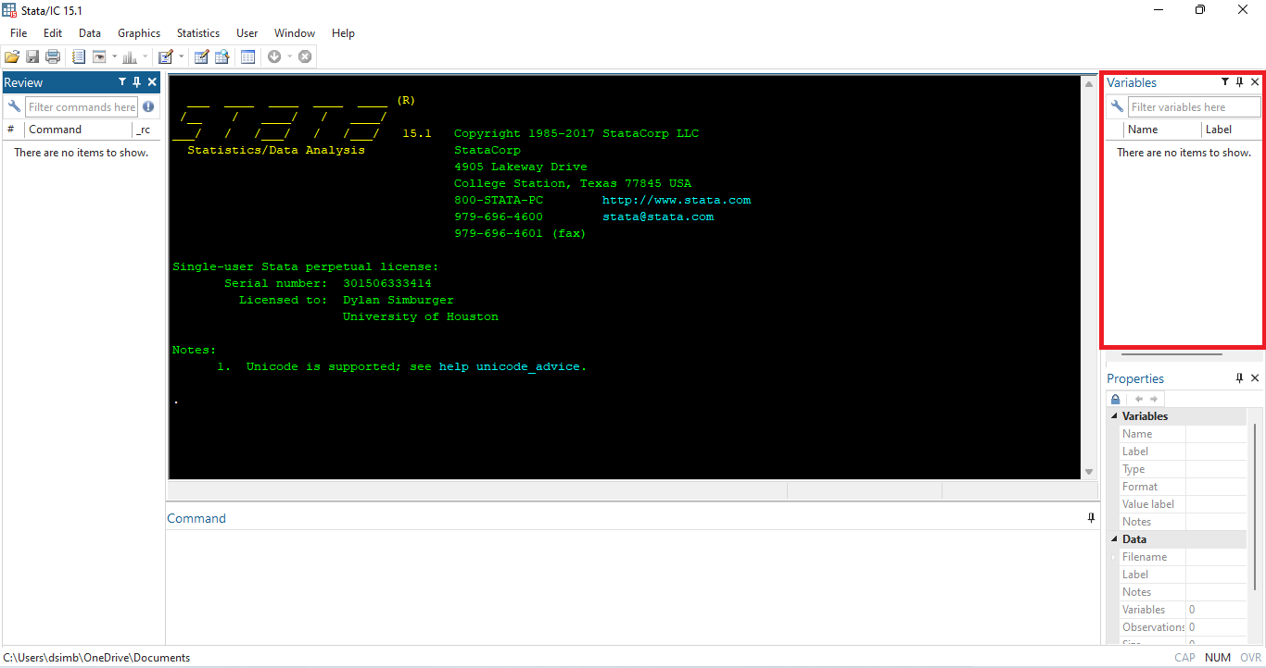
The Stata Variable Environment

Slide 10
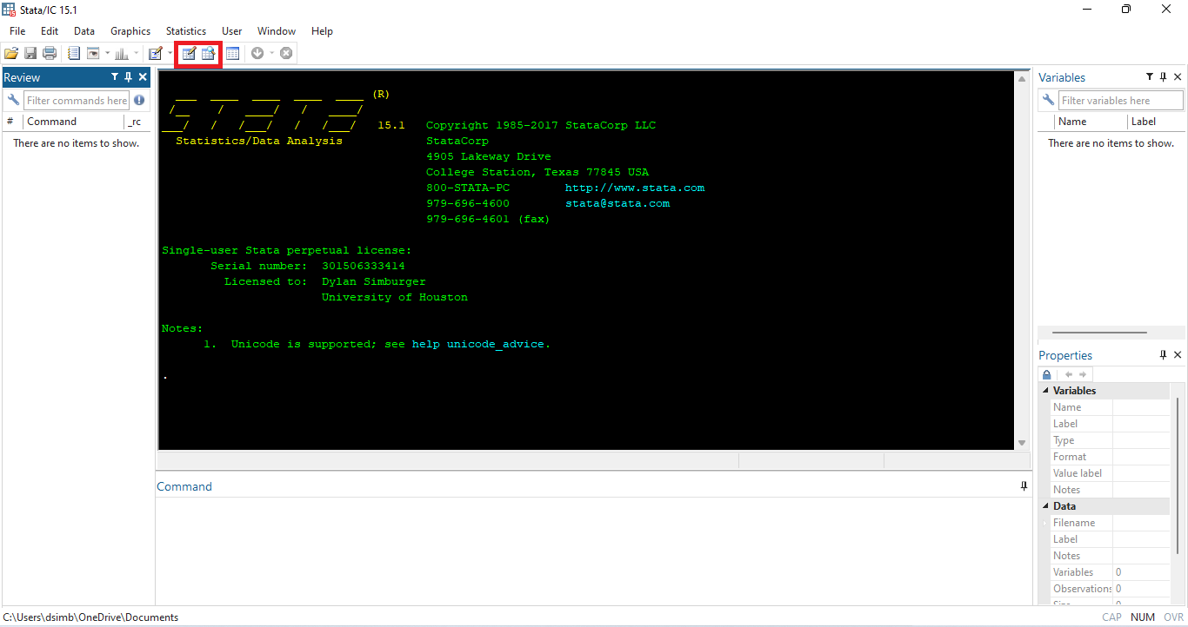
The Stata Data Editor/Browser

Slide 11
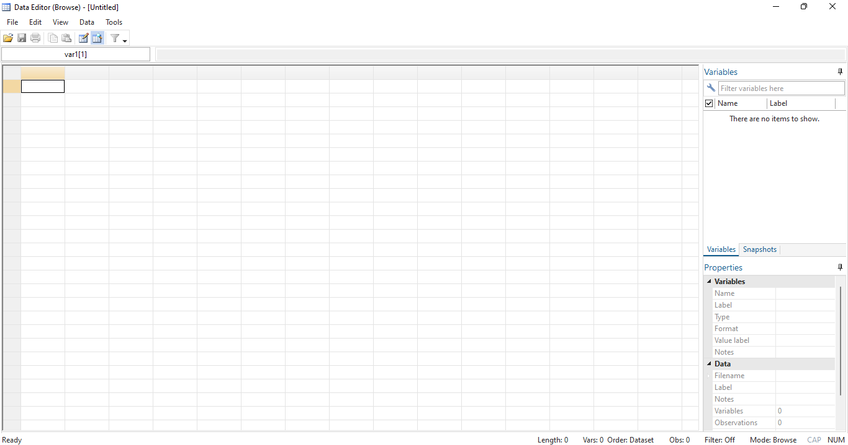
The Stata Data Editor/Browser

Slide 12
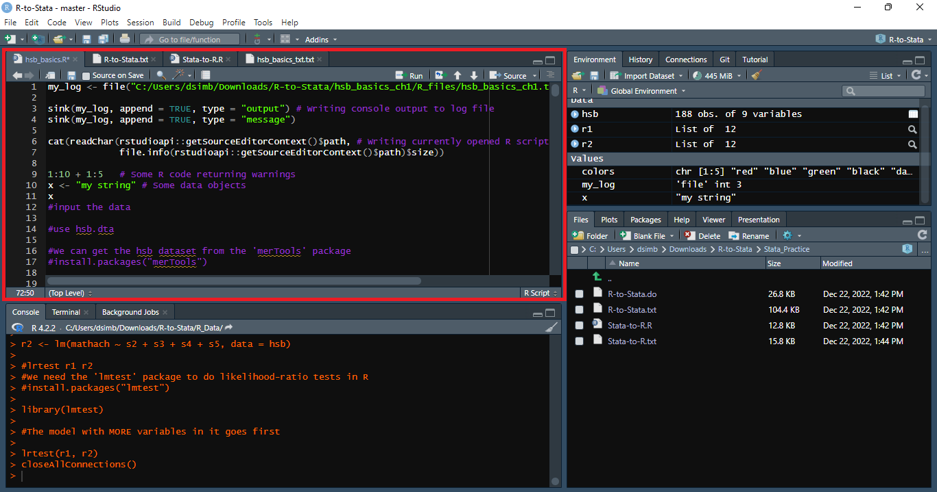
RStudio Scripts

Slide 13
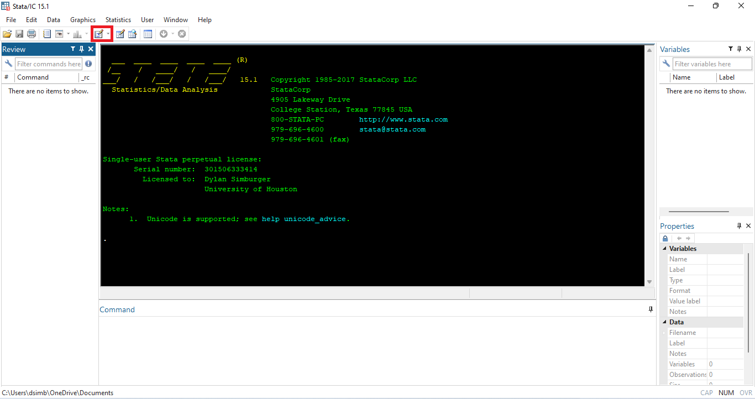
Stata .do Files (Stata Scripts)

Slide 14
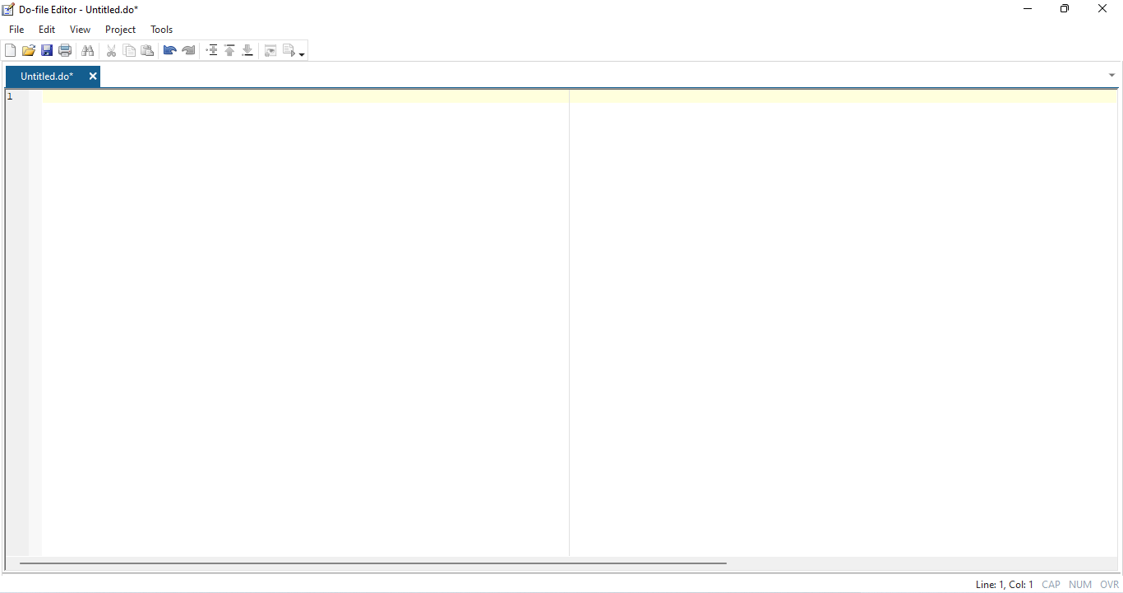
Stata .do Files (Stata Scripts)

Slide 15
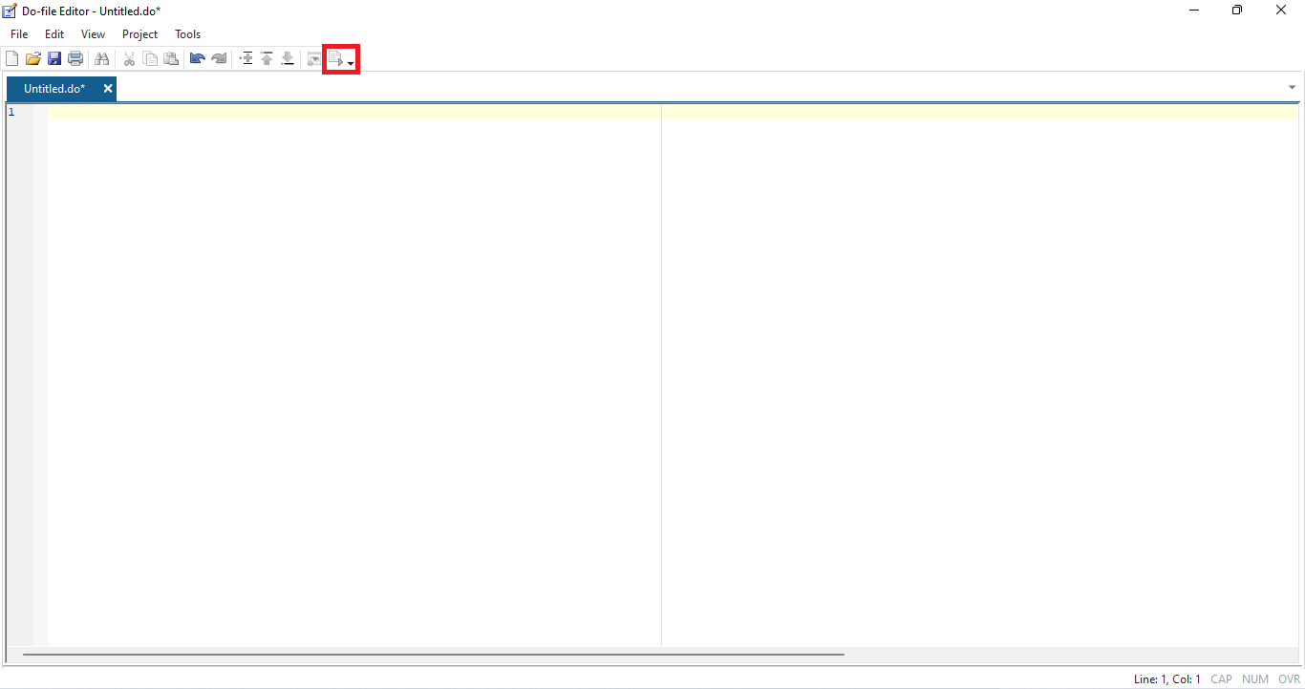
Stata .do Files (Stata Scripts)

Slide 16
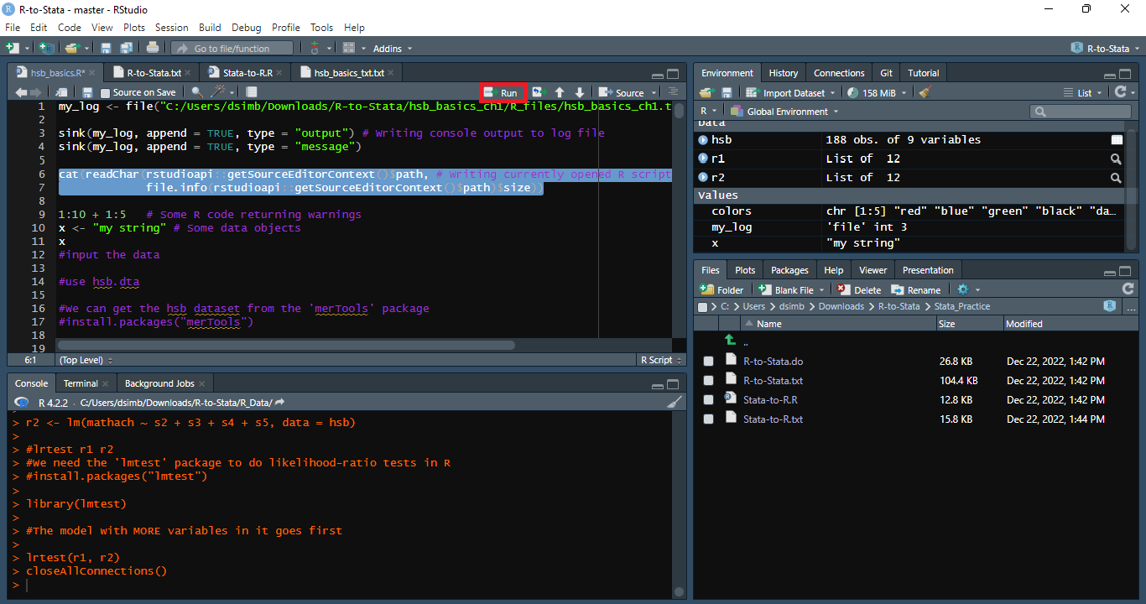
Running Chunks of a Script in RStudio

Slide 17
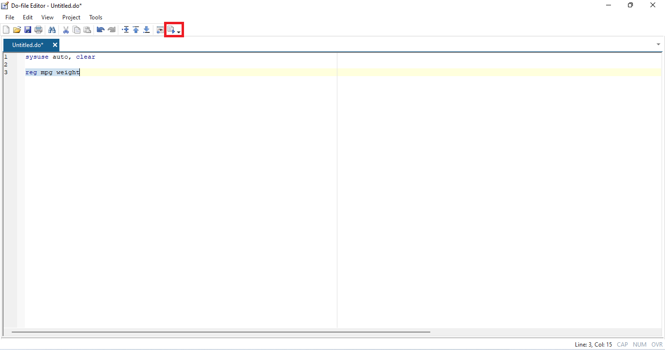
Running Chunks of a .do File in Stata

Slide 18
University of Arizona School of Sociology SOC570B graduate students can email any questions they have to:
Dylan Simburger: dsimburger@arizona.edu (Stata or R)
James Shockey: jshockey@arizona.edu (Stata)
Diego Leal: dflc@arizona.edu (R)

